Slide 1

1
ECTE250
ENGINEERING
DESIGN
AND
MANAGEMENT
2
Winter 2025 / Spring 2025
Reading Datasheet

Slide 2

Reading Datasheets
◻ We have chosen the D flip
flop Datasheet as
many
of you have already used this component in
ECTE233
◻ This is just to ensure that you are familiar with
using
datasheets produced
devices especially as
ECTE250 projects
by manufacturers
of electronic
power usage is
a
factor
in
2

Slide 3
Datasheets
◻ The first thing to look for in a Datasheet is the
device name and its part number
◻ Usually the part number is written on the actual
device (if its an Integrated Circuit) so you can do
the reverse process and find the datasheet by part
number or by name
◻ We will assume that you have the data
relevant datasheets are on Moodle for
sheet (most
your use)
3

Slide 4
D type Flip Flop Datasheet
◻ Firs part is
the
the
Information about operation, usually
located
on
first
useful
page
of
the
datasheet.
4

Slide 5
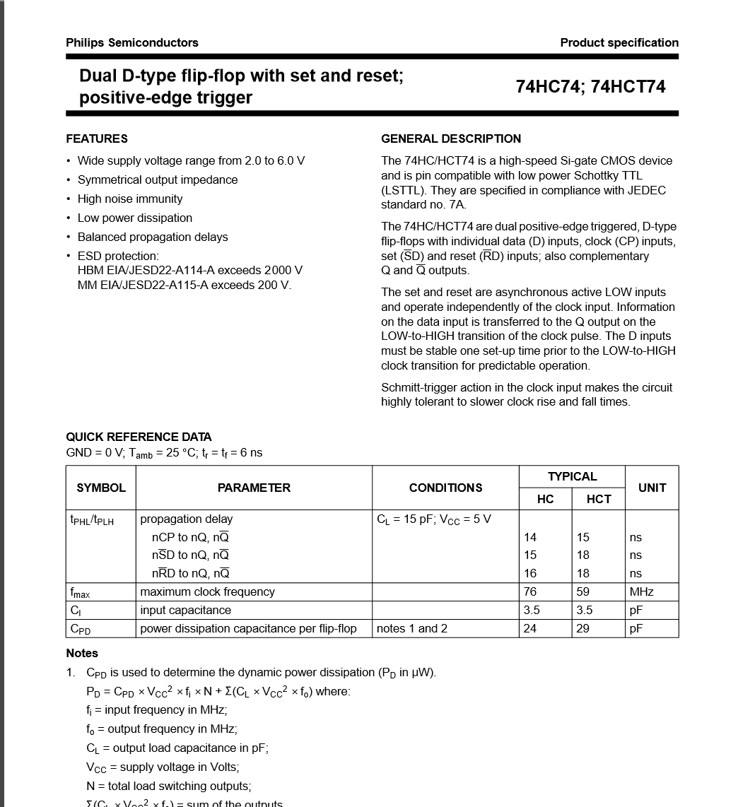
Name of the device,
Here a Dual (meaning 2 of)
D-type flip
flops!
5

Slide 6
Here is the manufacturers
Part number, 74HC74
this part may be produced
by more than one manufacturer
but they will always use the same
part number of the same device.
Here the manufacturer is Phillips
if it was another manufacturer the
functionality would still be very
close (if not exactly the same)
to the Phillips equivalent
6

Slide 7
Here are the special features
of this particular device (these
could be manufacturer
specific, though again they seem
to all be quiet similar)
7

Slide 8
Here is a description of the
functional operation of the
device and information
about whether its rising
edge of clock (positive edge
triggered ) or falling edge of
clock (negative edge triggered)
for flip flop output changes
8

Slide 9
Here is information about
propagation delays (in
nano seconds) and maximum
clock frequencies. The
systems in ECTE250 should not
normally approach these
frequencies but if designing clocks
around 50-100MHz will need to
decide if these flip flops are
suitable
9

Slide 10
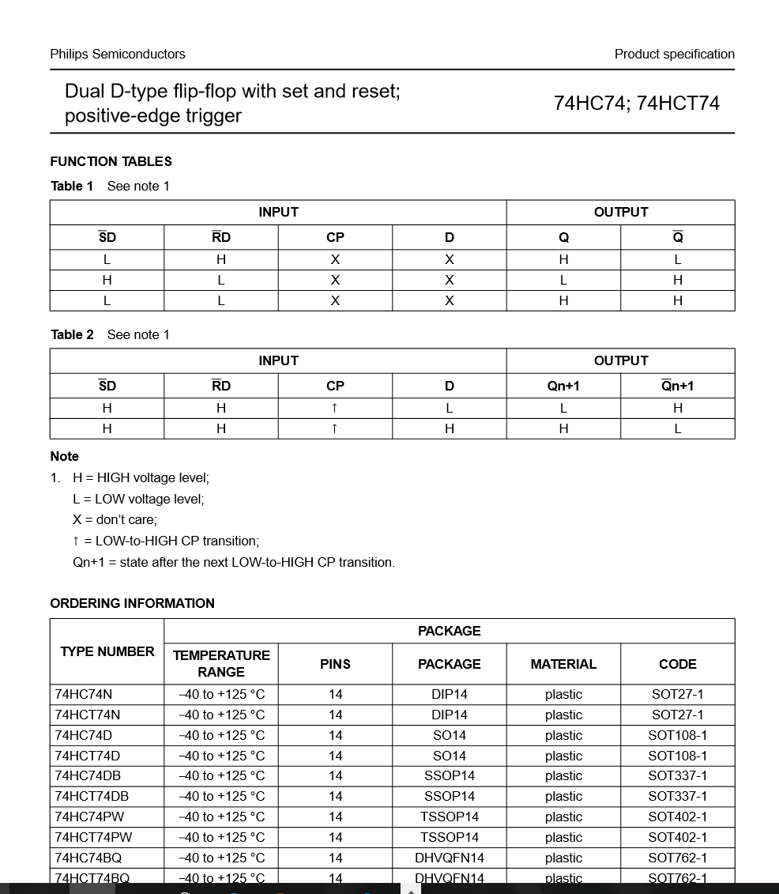
The second page shows
the Logical Function Table
for the flip flop
with a legend below which
shows for example ‘x’ is a
don’t care, H is a High voltage
and L is a low voltage
10

Slide 11
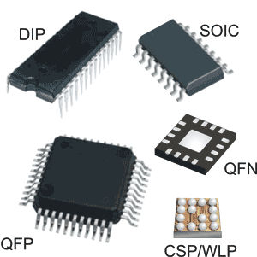
The second page also shows
the different types of this IC
that can be ordered in different
packaging and manufacturer
ordering codes, for example the DIP14
is the common IC packaging that
will be used in the laboratory. Physical
dimensional drawings of the
different physical form factors for the
different packaging of the IC are shown
further into the datasheet.
11

Slide 12
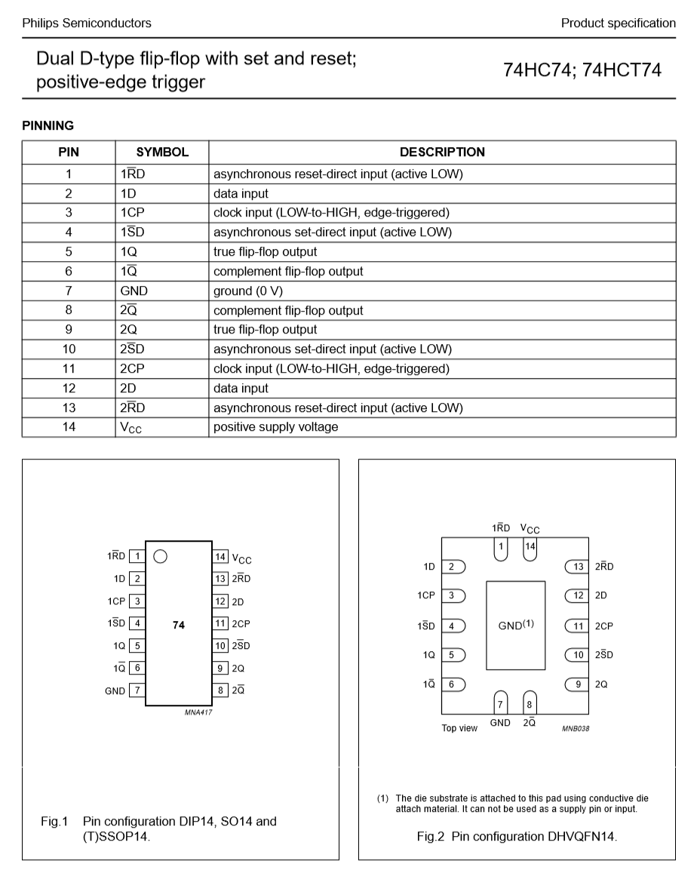
The third page shows
the pin out and functional information
for each pin on the IC, for example
ground is shown as GND and is pin 7,
the DC Voltage supply is shown as
Vcc and is Pin 14
12

Slide 13
The third page shows
the DIP14 packaging
of the IC which uses the
symbols above (eg GND
and Vcc) to indicate
location and function
of each pin as you connect
it to your circuit
via breadboard
or via IC socket (in the
case of perfoboard)
The little circle or dot
in the drawing is
physically present on
the chip and indicates
the location of Pin 1.
13

Slide 14
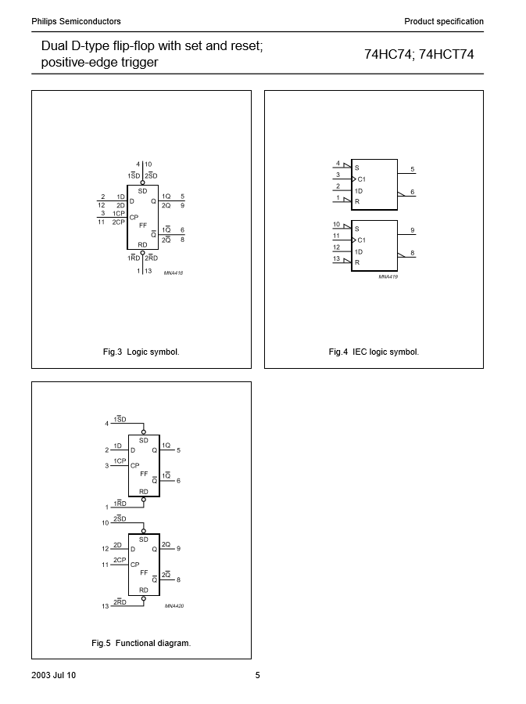
The fourth page shows
the logical function of
the device as it may
appear in an
electrical schematic
drawing of the system.
This will be required
for your detailed
design free hand drawings
and the final
report at the end of
Session in week 12.
IEC shows the International
Electrotechnical way of
drawing this circuit
in a schematic (we are
happy with Fig 5’s
representation)
14

Slide 15
Philips Semiconductors
Product specification
Dual 0-type flip-flop with set and reset;
positive-edge trigger
74HC74; 74HCT74
RECOMMENDED OPERATING CONDITIONS
SYMBOL
PARAMETER
CONDITIONS
74HC74
74HCT74
UNIT
MIN.
TYP.
MAX.
MIN.
TYP.
MAX.
Vee
v,
supply voltage
2.0
5.0
6.0
4.5
5.0
5.5
v
input voltage
0
-
Vee
0
-
Vee
v
Vo
output voltage
0
-
Vee
0
-
Vee
v
Tamb
operating ambient temperature
-40
+25
+125
-40
+25
+125
oc
Ir, 11
input rise and fall times
Vcc=2.0V
-
-
1000
-
-
500
ns
The sixth page
shows
details about
recommended
voltage, current
and power
levels for the IC,
with minimum,
typical and
maximum values.
Use these for
power
calculations!
15
Vee= 4.5 V
-
6.0
500
-
6.0
500
ns
Vee= 6.0V
-
-
400
-
-
500
ns
LIMITING VALUES
In accordance with the Absolute Maximum Rating System (IEC 60134);
voltages are referenced to GND (ground = 0 V).
SYMBOL
PARAMETER
CONDITIONS
MIN.
MAX.
UNIT
Vee
supply voltage
-0.5
+7.0
v
l1K
input diode current
V1 < -0.5 VorV1 >Vee+ 0.5 V;
note 1
-
±20
mA
loK
output diode current
Vo< -0.5 V or Vo> Vee+ 0.5 V;
note 1
-
±20
mA
lo
output source or sink current
-0.5 V <Vo< Vee+ 0.5 V; note 1
-
±25
mA
Ice. IGND
Vee or GND current
-
±100
mA
oc
Tstg
storage temperature
-65
+150
Ptot
power dissipation
Tamb = -40 to +125 °C; note 2
-
500
mW
Notes
1. The input and output voltage ratings may be exceeded if the input and output current ratings are observed.
2. For S014 packages: above 70 °C derate linearly with 8 mW/K.
For SSOP14 and TSSOP14 packages: above 60 °C derate linearly with 5.5 mW/K.
For DHVQFN14 packages: above 60 °C derate linearly with 4.5 mW/K.
For DIP14 packages: above 70 -c derate linearly with 12 mW/K.

Slide 16
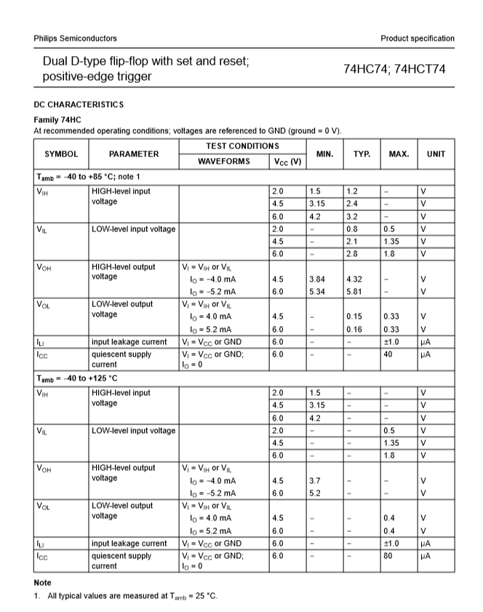
The seventh page shows details
for the 74HC family chips, again
with minimum, typical, and
maximum values for various
voltages and currents. After this
we get the different families of
these chips eg 74HCT and the test
circuits used, AC measurements,
AC waveforms in timing diagram
form and physical drawings of
pinouts (normally we don’t look
too close at these in practice
unless operating circuits at their
extremes or needing to design
physical layouts for circuits in
enclosures).
16

Slide 17
Data sheets
◻ Sometimes data sheets will show typical circuit
applications (the
did not have this
D Flip flop data sheet form Phillips
feature)
especially if
an
IC
is
new
or
rarely
used.
17

